Slide 1

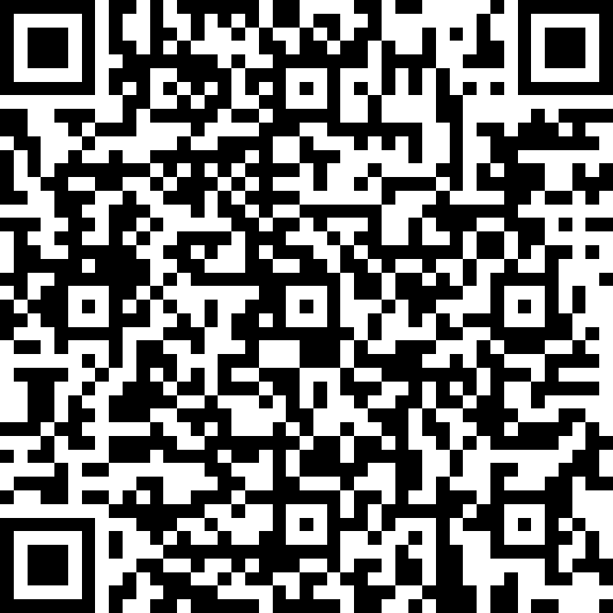
Microsoft Entra ID Governance POC Feedback
https://aka.ms/IGAPOCSurvey

Slide 2
Identity Governance and Administration Proof of concept
Govern privileged identities and their access
<<Subtitle or speaker name>>

Slide 3
Proof of concept (PoC) | Goals
Govern privileged identities and their access
Demonstrate the value of Microsoft Entra ID Governance in your environment:
Discovery: Identify current security practices around privileged identities.
Does the organization have any just in time access policies in place
Does the organization have identity proofing before elevating to a privileged role
Are their any audit controls around such policies
Define: Criteria for success of the POC is based on implementing those security controls for a subset of privileged identities
Evaluate: Evaluate the result of the POC by collecting customer feedback and team insights

Slide 4
Scenario’s Key Requirements
Make sure you meet these requirements to avoid any roadblocks
Identities with Privileged roles that wish to POC on-demand, approval-based just in time administrative access activation to Azure resources, Microsoft Entra ID roles and Apps via Group memberships
Privileged Roles Health Check and Require Compliant devices or Authentication Strengths on role activation

Slide 5
PoC Stakeholders
Common customer stakeholders
We will engage the following stakeholders at specific stages of the POC:
Identity team: Microsoft Entra ID Global Administrator
Security Team
Compliance Manager
Microsoft stakeholder
PoC driver: Microsoft engineer who will guide you during the PoC process

Slide 6
PoC | Timeline
Delivery stages
Discovery and Insights
Microsoft Entra ID Roles
Access Reviews + PIM
PIM for groups
Azure Roles
PIM + CA
Close-out
1 hour
1 hour
1 hour
1 hour
1 hour
1 hour
1 hour
7 hours
Logistics
Each stage will only require participation of a subset of stakeholders from customer
Times are estimated based on scenario complexity

Slide 7
PoC | Pre-work
Perform a discovery of current customer’s processes for user’s lifecycle
Collect Architectural diagrams (if existing)
We recommend using a pilot group of users for each scenario
Identify technical owners of the PoC resources, in case remediation/investigations are needed
Account with User administrator, Identity Governance Administrator, Privileged Role Administrator or Global administrator on the target tenant

Slide 8
PoC | Phase 1: Discovery and Insights
Discovery and Insights
Microsoft Entra ID Roles
Access Reviews + PIM
PIM for groups
Azure Roles
PIM + CA
Close-out
1 hour
1 hour
1 hour
1 hour
1 hour
1 hour
1 hour
Working session: 1 hour
Role | Responsibility
Microsoft Entra ID Global Admin | →Activate Trial and initial setup
Security Admin | →Ensure solution meets organizational security policies
Compliance Manager | →Ensure solutions complies with regulations
Privileged Roles Administrator | →Configure Roles and settings for PIM

Slide 9
PoC | Phase 2: Microsoft Entra ID Roles
Discovery and Insights
Microsoft Entra ID Roles
Access Reviews + PIM
PIM for groups
Azure Roles
PIM + CA
Close-out
1 hour
1 hour
1 hour
1 hour
1 hour
1 hour
1 hour
Working session: 1 hour
Role | Responsibility
Microsoft Entra ID Global Admin | →Setup Microsoft Entra ID roles settings
Security Admin | →Validate Roles to be managed and decision making for Role settings
Privileged Roles Administrator | →Configure Roles and settings for PIM

Slide 10
PoC | Phase 3: Azure Roles
Discovery and Insights
Microsoft Entra ID Roles
Access Reviews + PIM
PIM for groups
Azure Roles
PIM + CA
Close-out
1 hour
1 hour
1 hour
1 hour
1 hour
1 hour
1 hour
Working session: 1 hour
Role | Responsibility
Microsoft Entra ID Global Admin | →Setup Azure Role Settings
Security Admin | →Validate Roles to be managed and decision making for Role settings
Privileged Roles Administrator | →Configure Roles and settings for PIM

Slide 11
PoC | Phase 4: PIM for groups
Discovery and Insights
Microsoft Entra ID Roles
Access Reviews + PIM
PIM for groups
Azure Roles
PIM + CA
Close-out
1 hour
1 hour
1 hour
1 hour
1 hour
1 hour
1 hour
Working session: 1 hour
Role | Responsibility
Microsoft Entra ID Global Admin | →Setup Group Role Settings
Security Admin | →Validate groups to be managed and decision making for group settings
Privileged Roles Administrator | →Configure Roles and settings for PIM

Slide 12
PoC | Phase 5: Access reviews and PIM
Discovery and Insights
Microsoft Entra ID Roles
Access Reviews + PIM
PIM for groups
Azure Roles
PIM + CA
Close-out
1 hour
1 hour
1 hour
1 hour
1 hour
1 hour
1 hour
Working session: 1 hour
Role | Responsibility
Microsoft Entra ID Global Admin | →Setup Access Review settings on PIM policies
Security Admin | →Validate Access Reviews solution
Compliance Manager | → Validate solution meets requirements
Privileged Roles Administrator | →Configure Roles and settings for PIM

Slide 13
PoC | Phase 6: PIM + Conditional Access
Discovery and Insights
Microsoft Entra ID Roles
Access Reviews + PIM
PIM for groups
Azure Roles
PIM + CA
Close-out
1 hour
1 hour
1 hour
1 hour
1 hour
1 hour
1 hour
Working session: 1 hour
Role | Responsibility
Microsoft Entra ID Global Admin | →Setup Conditional Access Context settings and PIM policies
Security Admin | →Validate solution meets security requirements
Compliance Manager | → Validate solution meets requirements (If applicable)
Privileged Roles Administrator | →Configure Roles and settings for PIM

Slide 14
PoC | Phase 6: Close Out
Discovery and Insights
Microsoft Entra ID Roles
Access Reviews + PIM
PIM for groups
Azure Roles
PIM + CA
Close-out
1 hour
1 hour
1 hour
1 hour
1 hour
1 hour
1 hour
Wrap-up session (1 hour)
Who?
→ All teams
→ Leadership team
Goal
Present POC results
Discuss strategy to further implement
Fill out PoC closeout survey

Slide 15
PoC | Phase 5: Close-out
SaaS Apps provisioning
Lifecycle workflows
HR provisioning
Close-out
3 hours
1 hour
3 hours
1 hour
Wrap-up session (1 hour)
Who?
→ All teams
→ Leadership team
Goal
Present POC results
Discuss strategy to further implement
Fill out POC closeout survey

Slide 16
Microsoft Entra ID Governance features used on this scenario
Feature | Description | Stage | Microsoft Entra ID Governance SKU
Privileged Identity Management (PIM) | Enables you to manage, control, and monitor access to important resources in your organization. | General Availability | No
PIM For Groups | Provide users just-in-time membership in the group and just-in-time ownership of the group using the Microsoft Entra ID Privileged Identity Management for Groups feature | General Availability | No
PIM CA Controls | Feature that allows users who are eligible for a role to satisfy Conditional Access policy requirements | General Availability | No
Source
Microsoft Entra ID Governance licensing fundamentals
Notes:
The following governance features went GA and are part of the Microsoft Entra ID Governance SKU:
Lifecycle workflows (LCW) – Enables you to use custom workflows to automate identity lifecycle management tasks for your Microsoft Entra ID users by managing your joiner, mover, and leaver lifecycle processes. With LCW, you can leverage Microsoft Entra ID to confidently deploy workflows to configure out-of-the-box actions to onboard and offboard your employees.
LCW + Custom Extensions (Logic Apps) - Lifecycle Workflows can be used to trigger custom tasks via an extension to Azure Logic Apps.

Slide 17
Introduction
Privileged Identity Management (PIM) is a service in Microsoft Entra ID that enables you to manage, control, and monitor access to important resources in your organization. These resources include resources in Microsoft Entra ID, Azure, and other Microsoft Online Services such as Microsoft 365 or Microsoft Intune

Slide 18





Microsoft Entra ID Privileged Identity Management
Just in Time
Access
Just Enough
Access
Privileged Admin
Workflow
Audit-ready
Protect and control privileged access to your organization

Slide 19
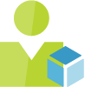
Privileged Identity Management (PIM)
Manage and audit admin roles across Azure, Microsoft Entra ID and Microsoft 365
See which users are assigned privileged roles.
Enable on-demand, "just in time" administrative access.
Set up approval flows for privilege activation.
Get alerts and view a history of administrator activation and actions.
Works for:
Microsoft Entra ID directory roles
Azure Resource roles
Privileged Access Groups (Public Preview)
Contoso Expenses App Moderator
Intune Role Administrator
DevTest Labs User
Security Reader
Virtual Machine User Login

Slide 20
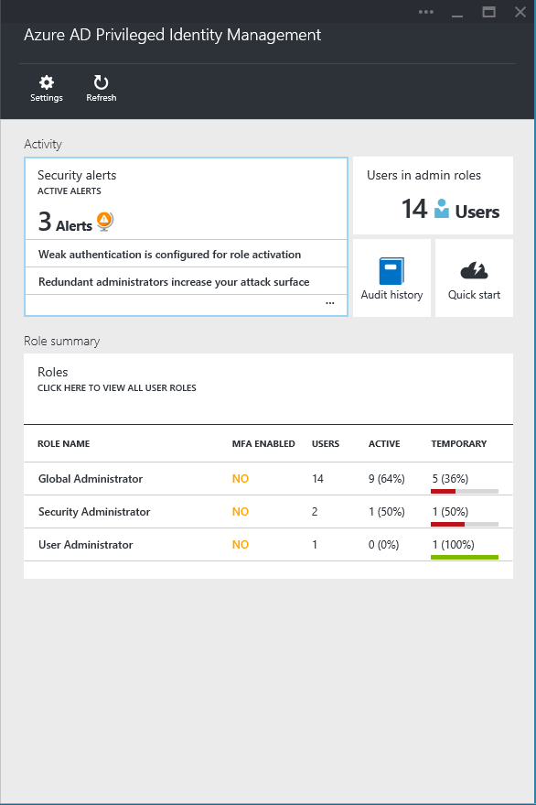
Privileged Identity Management
User
Administrator
Administrator privileges expire after a specified interval
User
Enforce on-demand, just-in-time administrative access when needed
Ensure policies are met with alerts, audit reports and access reviews
Manage admins access in Microsoft Entra ID and also in Azure RBAC

Slide 21



What you can manage in PIM
Azure Roles
Microsoft Entra ID Roles
Groups

Slide 22
What you can manage in PIM
The role-based access control (RBAC) roles in Azure that grants access to management groups, subscriptions, resource groups, and resources.
Azure Roles
Privileged Roles include built-in and custom roles to manage Microsoft Entra ID and other Microsoft 365 online services.
Microsoft Entra ID Roles
PIM for groups allows you to setup just-in-time access to member and owner role of an Microsoft Entra ID security group, alternatively you can use these groups for Microsoft Entra ID roles and Azure roles assignments and other permissions within Microsoft online services
Groups

Slide 23
Privileged Identity Management high level flow
Bring under management
Applicable for Azure roles and Groups
Set role settings
Define assignment process and requirements
Assign
Activate
Eligible or permanent
Approve / Reject
If eligible, follow process to activate the role
For roles that require approval
Extend or renew
When assignment end approaches
Alert
Audit
Review

Slide 24

Microsoft Entra ID PIM assignment types
Eligible assignments: require the member to activate the role before using it. Administrator may require role member to perform certain actions before role activation which might include performing a multi-factor authentication (MFA) check, providing a business justification, or requesting approval from designated approvers.
Active assignments: don't require the member to activate the role before usage. Members assigned as active have the privileges assigned ready to use. This type of assignment is also available to customers that don't use Microsoft Entra ID PIM.

Slide 25
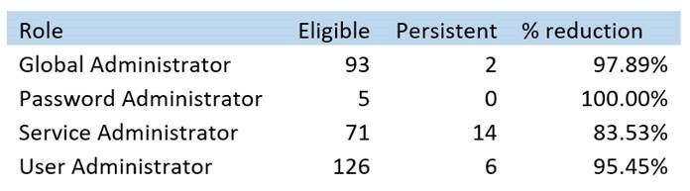
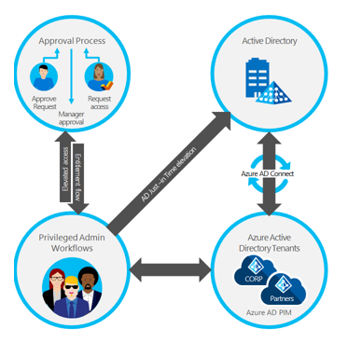
Deploying Privileged Identity Management
Discovery, delegation, automation
Step 1
1
Used Discovery Wizard to find the privileged administrators
Step 2
2
Removed users from privileged roles
Moved some user to less privileged roles (delegation)
Step 3
3
Integrated Microsoft Entra ID PIM activation into privileged administrator workflows (through APIs)
Ongoing review of audit activity

Slide 26
Discovery and Insights (Preview)

Slide 27
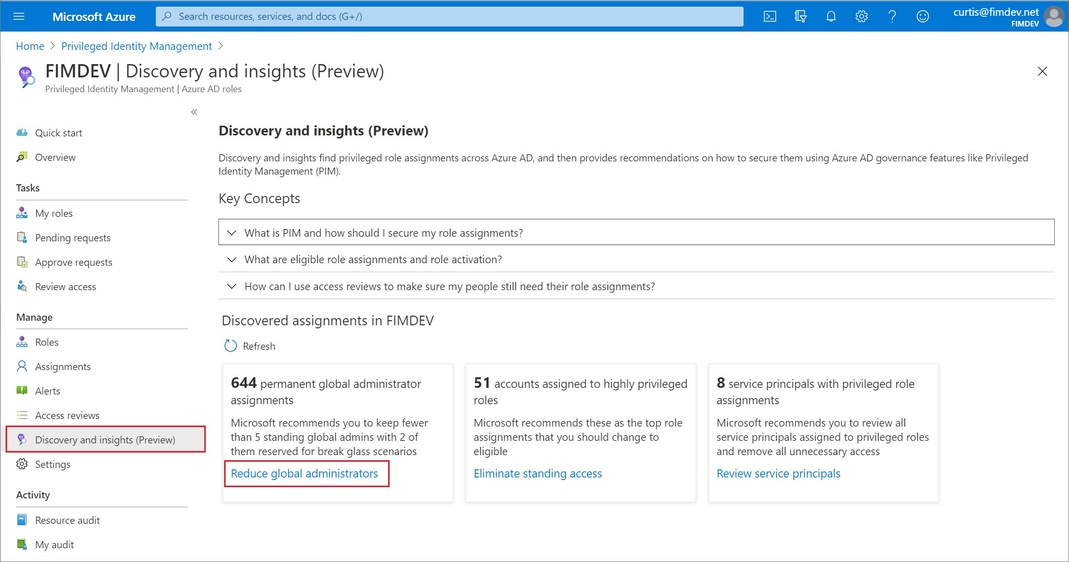
Discovery and Insights (Preview)
Lists all privileged roles and how many users are currently holding those roles
Learn more about the assigned users if one or more of them are unfamiliar.
Move users to eligible status or just remove them from the role completely
Create Access reviews for global admins

Slide 28
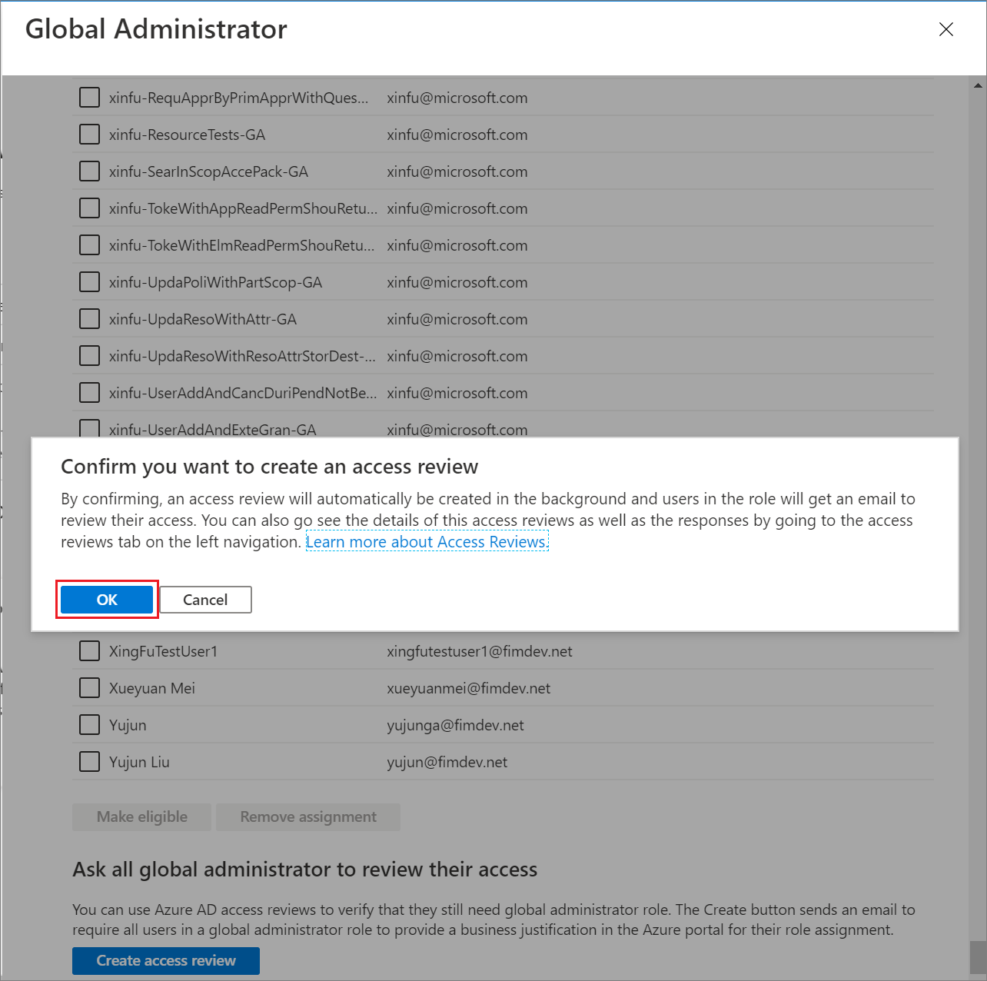
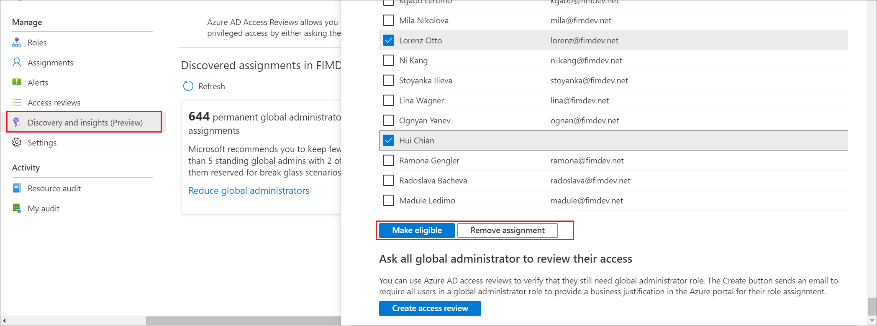
Discovery and Insights (Preview)
Create Access Review
Remove assignment or Make user eligible for the role

Slide 29
PIM for Microsoft Entra ID roles

Slide 30
How to use PIM for Microsoft Entra ID roles
Microsoft Entra ID Roles
Configure Microsoft Entra ID roles
Give eligible assignments
Allow eligible users to activate their Azure roles just-in-time
Select the resource you want to manage
Review settings and PIM policies
Configure settings like:
Activation max duration
MFA on activation
Require conditional access authentication context
Require justification
Require ticket information
Require approval
Assignment duration
For those who may require to elevate to a privileged Microsoft Entra ID role
Users can activate their eligible roles through Microsoft Entra portal -> My roles

Slide 31
PIM for Azure Roles

Slide 32
How to use PIM for Azure roles
Azure Roles
Discover Azure resources
If this is the first time , go to Entra portal -> PIM -> Azure resources -> Discover resources
After discovery is complete , select any unmanaged resource that you wish to manage under PIM
Configure Azure role settings
Select the resource you want to manage
Review settings and PIM policies
Configure settings like:
Activation max duration
MFA on activation
Require conditional access authentication context
Require justification
Require ticket information
Require approval
Assignment duration

Slide 33
How to use PIM for Azure roles (cont’d)
Give eligible assignments
For those who may require to elevate to a privileged role
Allow eligible users to activate their Azure roles just-in-time
Users can activate their eligible roles through Microsoft Entra portal -> My roles
Azure Roles
Tutorial : Prepare PIM for Azure roles

Slide 34
PIM for Groups

Slide 35
How to use PIM for Groups
Identify Groups to Manage
Assign eligibility for a group through PIM
Use the discovery process to bring groups to management
Select the users who are eligible for member or owner roles
Allow Eligible users to activate group membership or ownership
Users can activate their eligible roles through Microsoft Entra portal -> My roles
Groups
Tutorial : PIM for groups

Slide 36
PIM for Groups: Role-assignable vs non-role assignable
Role-Assignable
Non-role-assignable
Only the Global Administrator, Privileged Role Administrator, or the group Owner can manage the group
For security reasons, No other users can change the credentials of active members, this prevents elevation without approval
More Microsoft Entra ID roles can manage group
Various Roles can change the credentials of active members
Groups

Slide 37
PIM for Groups considerations
Role-assignable groups can’t have other groups nested
Groups must be an Microsoft Entra ID security group or a Microsoft 365 group
One group can be an eligible member of another group, even if one of those groups is role-assignable
If a user is an active member of Group A, and Group A is an eligible member of Group B, the user can activate their membership in Group B. This activation will be only for the user that requested the activation for, it does not mean that the entire Group A becomes an active member of Group B

Slide 38
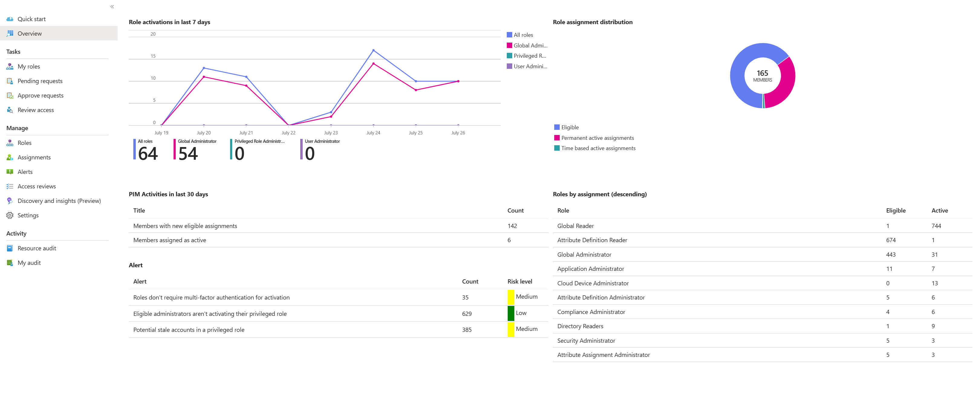
PIM dashboard
Notes:
You can use a resource dashboard to perform an access review in Privileged Identity Management (PIM). The Admin View dashboard in Azure Active Directory (Azure AD), part of Microsoft Entra, has three primary components:
A graphical representation of resource role activations
Charts that display the distribution of role assignments by assignment type
A data area containing information to new role assignments

Slide 39
Access Reviews in PIM

Slide 40
How does Access Reviews work?
2. Review current membership with system generated recommendations
Administrator
1. Select resource
2. Select scope
Team/Group
SaaS application
Privileged role
Access Package
Guests
Employees
Everyone
3. Reviewers confirm which memberships to keep
1. Email is sent to the reviewer
3. Select reviewer
4. Select frequency
Team/Group owner
Manager*
Specific user(s)
Users’ self review
Weekly
Monthly
Quarterly
Annually
4. Denied users are removed from resource
Notes:
Access reviews can be used for:
Govern access to Microsoft Teams and O365 groups ​
Govern access to critical applications​
Reduce access risk of Azure AD B2B guests​
Ensure that users in privileged roles still require permissions ​
Review excessive access held by machine accounts​
Manage exception lists of Conditional Access policies

Slide 41
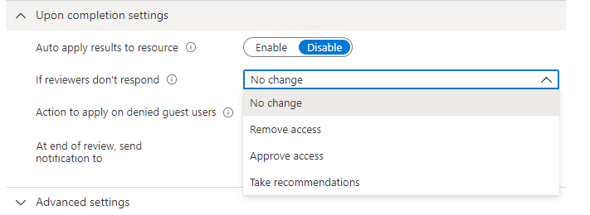
Access reviews in PIM
Used to Automate the discovery of stale roles assignments
Azure Roles and Microsoft Entra ID roles
Optionally, you can automatically remove the users from the role upon completion of the Access Review
Notes:
For Azure AD roles, role-assignable groups can be assigned to the role using role-assignable groups. When a review is created on an Azure AD role with role-assignable groups assigned, the group name shows up in the review without expanding the group membership. The reviewer can approve or deny access of the entire group to the role. Denied groups will lose their assignment to the role when review results are applied.
• For Azure resource roles, any security group can be assigned to the role. When a review is created on an Azure resource role with a security group assigned, the users assigned to that security group will be fully expanded and shown to the reviewer of the role. When a reviewer denies a user that was assigned to the role via the security group, the user will not be removed from the group, and therefore the apply of the deny result will be unsuccessful.

Slide 42
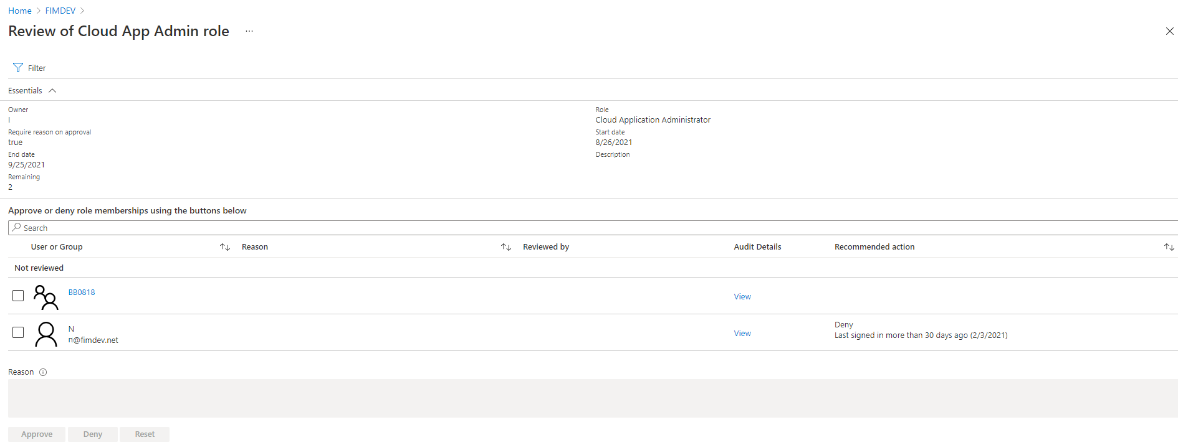
Perform and complete an Access review
You can approve or deny access based on whether the user still needs access to the role.
Choose Approve if you want them to stay in the role, or Deny if they do not need the access anymore.
The users' assignment status will not change until the review closes and the administrator applies the results

Slide 43
PIM + CA Integration
You can require users who are eligible for a role to satisfy conditional access policy requirements on elevation using Microsoft Entra ID Conditional Access Authentication Context.
This Allows administrators to add other security requirements through conditional access policies like:
Require elevation only from Intune-compliant device
Enforce specific strong authentication method like phishing resistant on role elevation

Slide 44
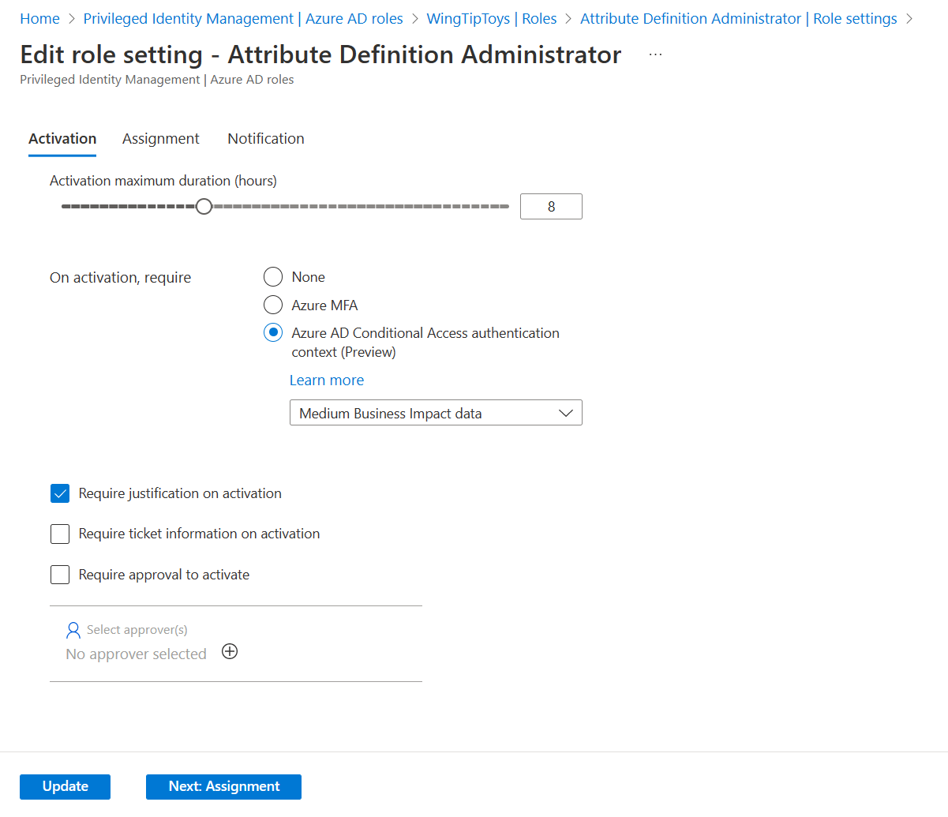
PIM + CA Integration
Create Authentication Context
Create CA policy with requirements using the authentication context
Edit Role settings to require the CA policy on Activation

Slide 45
POC Deployment - Privileged Identity Management
Title | Link
Bring under Management | Azure Resources → Discover Azure resources to manage in PIM Groups → Bring groups into Privileged Identity Management
Set role settings | Microsoft Entra ID Roles → Role settings for Microsoft Entra ID roles Azure Resources → Role settings for Azure resource Roles Groups → Group settings for PIM
Assign | Microsoft Entra ID Roles → Assign Microsoft Entra ID roles in PIM Azure Resources → Assign Azure resources in PIM Groups → Assign Groups in PIM
Activate | Microsoft Entra ID Roles → Activate Microsoft Entra ID roles in PIM Azure Resources → Activate Azure resources in PIM Groups → Activate Groups in PIM
Approve | Microsoft Entra ID Roles → Approve Microsoft Entra ID roles in PIM Azure Resources → Approve Azure resources in PIM Groups → Approve Groups in PIM
Extend or Renew | Microsoft Entra ID Roles → Extend Microsoft Entra ID roles in PIM Azure Resources → Extend Azure resources in PIM Groups → Extend Groups in PIM
Review Access | Create Access Review → Create an access review Perform Access Review → Perform an access review Complete Access Review → Complete an access review
PIM + CA | Require Microsoft Entra ID conditional access authentication context

Slide 46

Thank you

